Slide 1
Template Method

Slide 2
Intent
Define the skeleton of an algorithm in an operation, deferring some steps to subclasses.
Template Method lets subclasses redefine certain steps of an algorithm without changing the algorithm's structure.
.

Slide 3
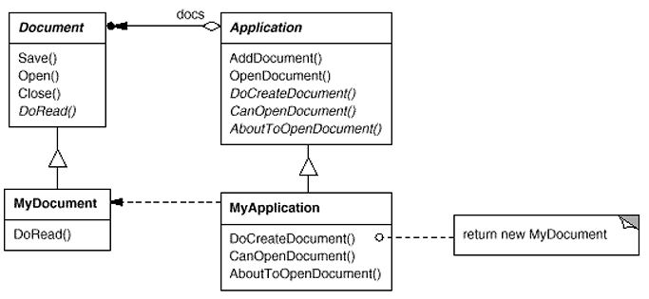
Motivation
Consider an application framework that provides Application and Document classes.
The Application class is responsible for opening existing documents stored in an external format, such as a file.

Slide 4
Motivation (cont…)
We call OpenDocument a template method.
A template method defines an algorithm in terms of abstract operations that subclasses override to provide concrete behavior.

Slide 5
Applicability
To implement the invariant parts of an algorithm once and leave it up to subclasses to implement the behavior that can vary.
To control subclasses extensions. You can define a template method that calls "hook" operations .

Slide 6
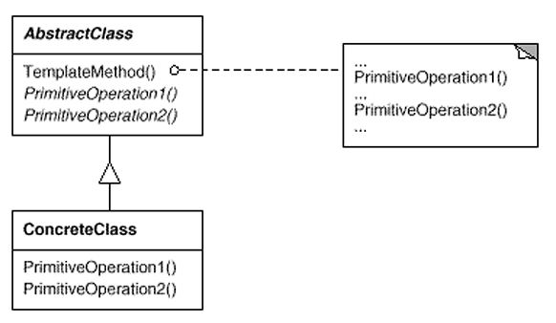
Structure

Slide 7
Participants
AbstractClass (Application)
  defines abstract primitive operations that concrete subclasses define to implement steps of an algorithm.
  implements a template method defining the skeleton of an algorithm. The template method calls primitive operations as well as operations defined in AbstractClass or those of other objects.
ConcreteClass (MyApplication)
  implements the primitive operations to carry out subclass-specific steps of the algorithm.

Slide 8
Collaborations
ConcreteClass relies on AbstractClass to implement the invariant steps of the algorithm.

Slide 9
Consequences
Template methods are a fundamental technique for code reuse. They are particularly important in class libraries, because they are the means for factoring out common behavior in library classes.
Template methods lead to an inverted control structure that's sometimes referred to as "the Hollywood principle," that is, "Don't call us, we'll call you“.
This refers to how a parent class calls the operations of a subclass and not the other way around.

Slide 10
Related Patterns
Factory Method
Strategy

